Slide 1
Promoting IWRM at national, international and cross-national level
Hans Christian Ammentorp

Slide 2
UNEP-DHI Centre on Water and Environment
Established 2001 at DHI, Denmark
Our work include:
Promoting Integrated Water Resources Management
Supporting climate change resilience
Enhancing management of water in the coastal zone
Developing ecosystem based management of freshwater

Slide 3
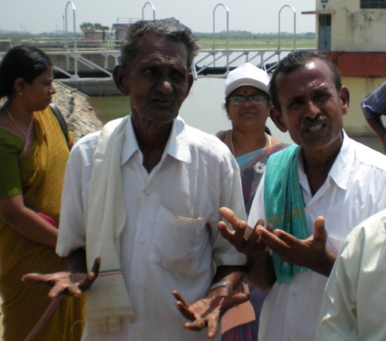
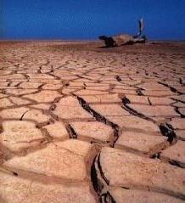
Integrated Water Resources Management
GWP definition:
Promote coordinated development and management of water
Maximise economic and social welfare in an equitable manner
Avoid compromising the sustainability of vital ecosystems

Slide 4
Creating the basis for improved water management
Kenya Uganda Tanzania Burundi Rwanda
WRIS – a Water Resources Information System for Monitoring Surface- and Groundwater and Water Quality conditions in Lake Victoria Basin
Notes:
Challenge
Solution
Value

Slide 5
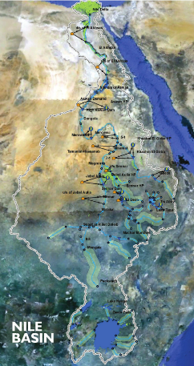
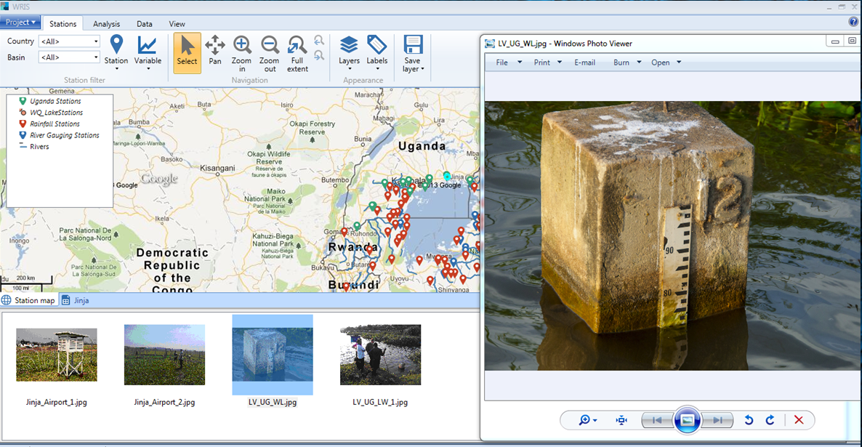
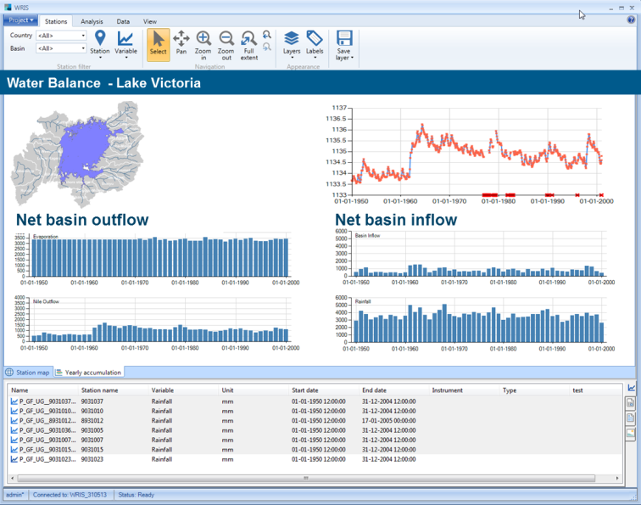
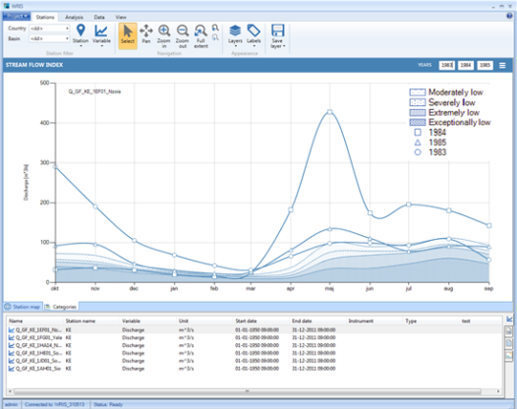
Creating the basis for improved water management
Lk. Vic
Zamwis
Sonoma
Data base
Making information available
Notes:
CLIENT
Lake Victoria Basin Commission (LVBC)
CHALLENGE
• Lack of the information technology (IT) infrastructure need to share data across countries
• Poor knowledge of available data on the basin and data sharing mechanisms
• Inability to maximise available data due to lack of tools
• Insufficient data due to sparse data monitoring
• Lack of data processing and data publishing capabilities
SOLUTION
Development of a Water Resources Information System (WRIS) – a data and knowledge repository that enables stakeholders to easily identify and access available information
VALUE
• Encourages data and knowledge sharing
• Enables stakeholders to display monitoring network and associated data records
• Enables analysis of hydrological and environmental data to support decision making
• Increases stakeholders’ incentive to provide reliable data for shared use
• Increases stakeholders’ knowledge of the environmental conditions in the basin
LOCATION / COUNTRY
Lake Victoria Basin, Africa

Slide 6
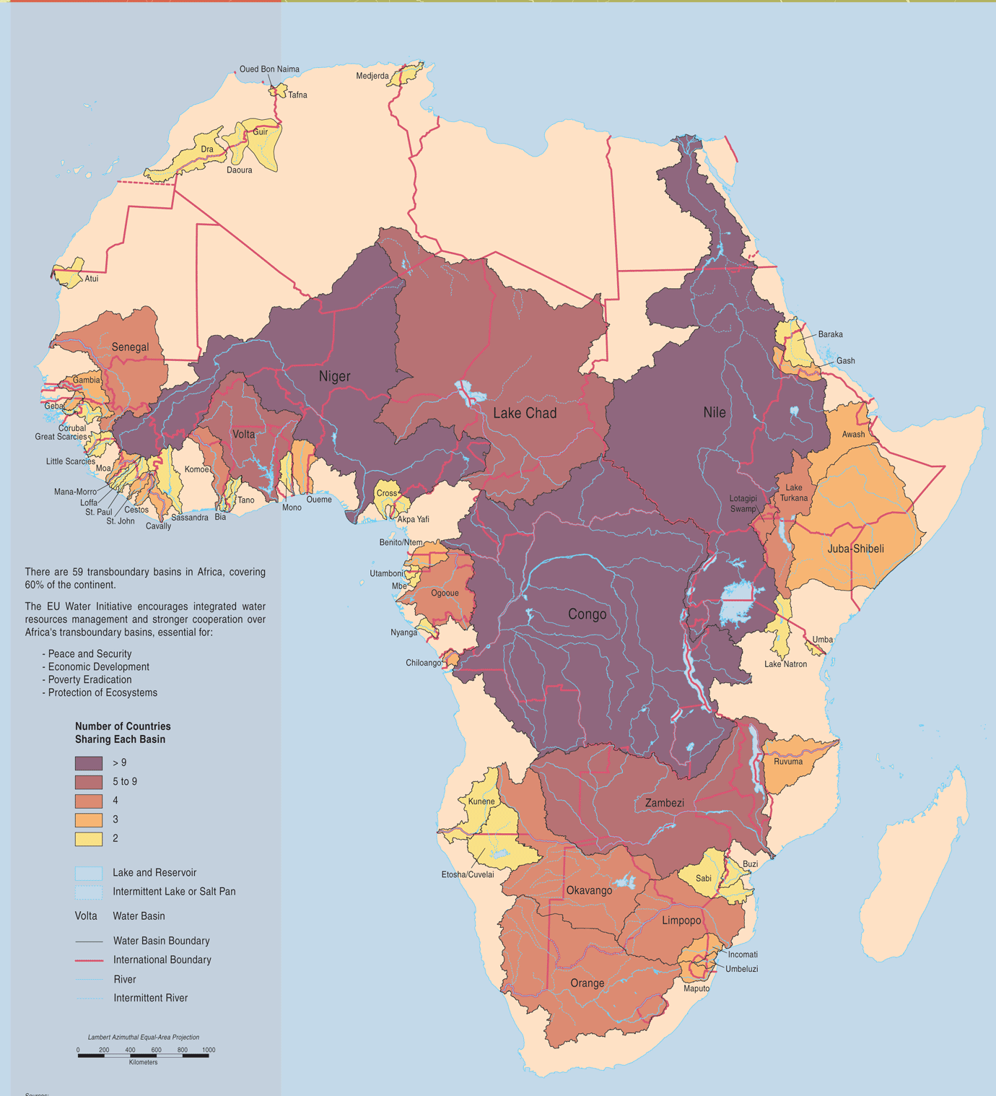
The Nile River
Worlds longest river – 6700 km
Area: 3.2 million km²
Shared by 11 countries
Population > 200 million
Water scarce areas
Rich natural and environmental assets

Slide 7
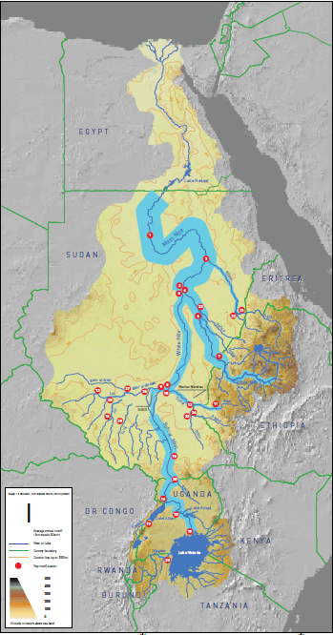
The Nile River
Project background:
Downstream countries that rely almost completely on the Nile water
Upstream countries with a desire and potential to develop water infrastructure
Water allocation agreements that inhibits upstream development projects
Environmental issues and important ecosystems (e.g. the Sudd, Lk. Vic)

Slide 8
Project data sheet

Slide 9
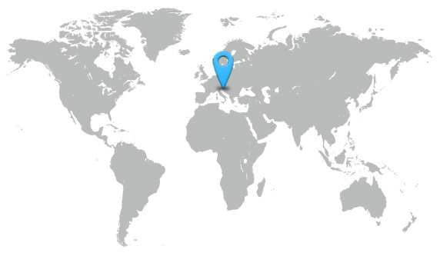
Early warning and forecast systems
An user-friendly online forecasting system providing decision makers with an overview of the entire river network, every hour 365 days/year.
You can too – with our software platform
Slovenia
With the new system we expect to reduce costs caused by flooding by 20-30%.”
Janez Polajnar, Head, Flood Forecasting Department,
ARSO
Notes:
Client Slovenian Environmental Agency (ARSO)
Challenge Setup and implementation of an upgraded, fast and reliable early flood warning system
Solution An up-to-date real time flood forecasting system with a user-friendly interface, used for the dissemination of early flood warnings
Value
• Better preparedness
• Optimised mitigation measures
• Reduced costs from flood damages and losses due to early action
• Improved and consistent overview of the river network

Slide 10
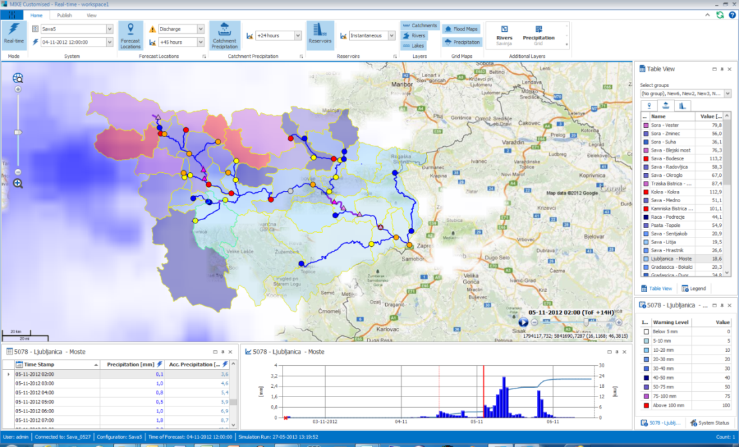
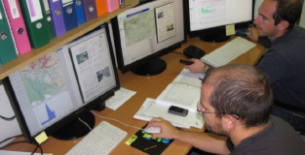
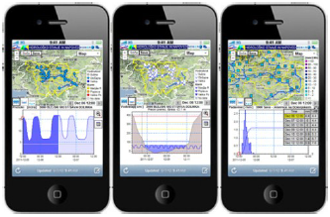
Early warning and forecast systems
The system is running automatically, providing new 6-day-forecasts at 74 locations in the network every hour 365 days/year.
Slovenia
Trained staff in the operation room
Sava
Web
Status map in MIKE OPERATIONS
Notes:
Client Slovenian Environmental Agency (ARSO)
Challenge Setup and implementation of an upgraded, fast and reliable early flood warning system
Solution An up-to-date real time flood forecasting system with a user-friendly interface, used for the dissemination of early flood warnings
Value
• Better preparedness
• Optimised mitigation measures
• Reduced costs from flood damages and losses due to early action
• Improved and consistent overview of the river network

Slide 11
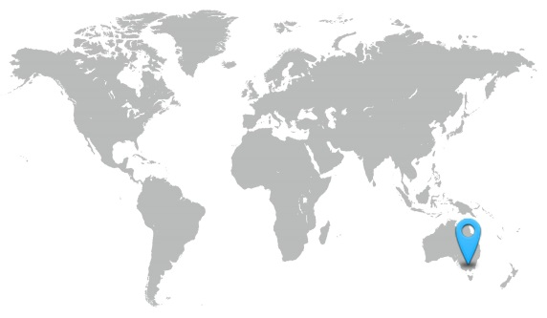
River operations
Over 1,600km of river with two dams and thousands of water users. One river management system.
You can too – with our Computer Aided River Management (CARM) system
New South Wales, Australia
CARM is a world class development designed to maximise the efficiency of the Murrumbidgee River system.”
Brett Tucker, Chief Executive Officer, State Water Corporation, New South Wales, Australia
Notes:
Challenge
The Murrumbidgee River supplies major irrigation areas in the Murray Darling Basin. The river is highly regulated to meet water requirements.
The NSW State Water Corporation (SWC), is seeking
to improve its water deliveries by optimising dam releases and reducing operational losses.
Solution
SWC will implement a Computer Assisted River Management system (CARM) to ensure that irrigators seeks and environmental customers along the river receive the right amount of water in the right location
and at the right time.
CARM integrates real time weather and river flow data with advanced hydraulic forecast models to determine optimum dam releases and river gate settings.
Value
CARM will assist river operators to make precise deliveries, minimise water losses and use saved water in the upstream reservoirs as an environmental flow reserve. The system, along with associated river
modernisation projects, aims to return 80 GL of water annually to the environment.

Slide 12
River operations
New South Wales, Australia
“The CARM project will make control of water flows more responsive and more precise.”
State Water Corporation
Notes:
Challenge
The Murrumbidgee River supplies major irrigation areas in the Murray Darling Basin. The river is highly regulated to meet water requirements.
The NSW State Water Corporation (SWC), is seeking
to improve its water deliveries by optimising dam releases and reducing operational losses.
Solution
SWC will implement a Computer Assisted River Management system (CARM) to ensure that irrigators seeks and environmental customers along the river receive the right amount of water in the right location
and at the right time.
CARM integrates real time weather and river flow data with advanced hydraulic forecast models to determine optimum dam releases and river gate settings.
Value
CARM will assist river operators to make precise deliveries, minimise water losses and use saved water in the upstream reservoirs as an environmental flow reserve. The system, along with associated river
modernisation projects, aims to return 80 GL of water annually to the environment.

Slide 13
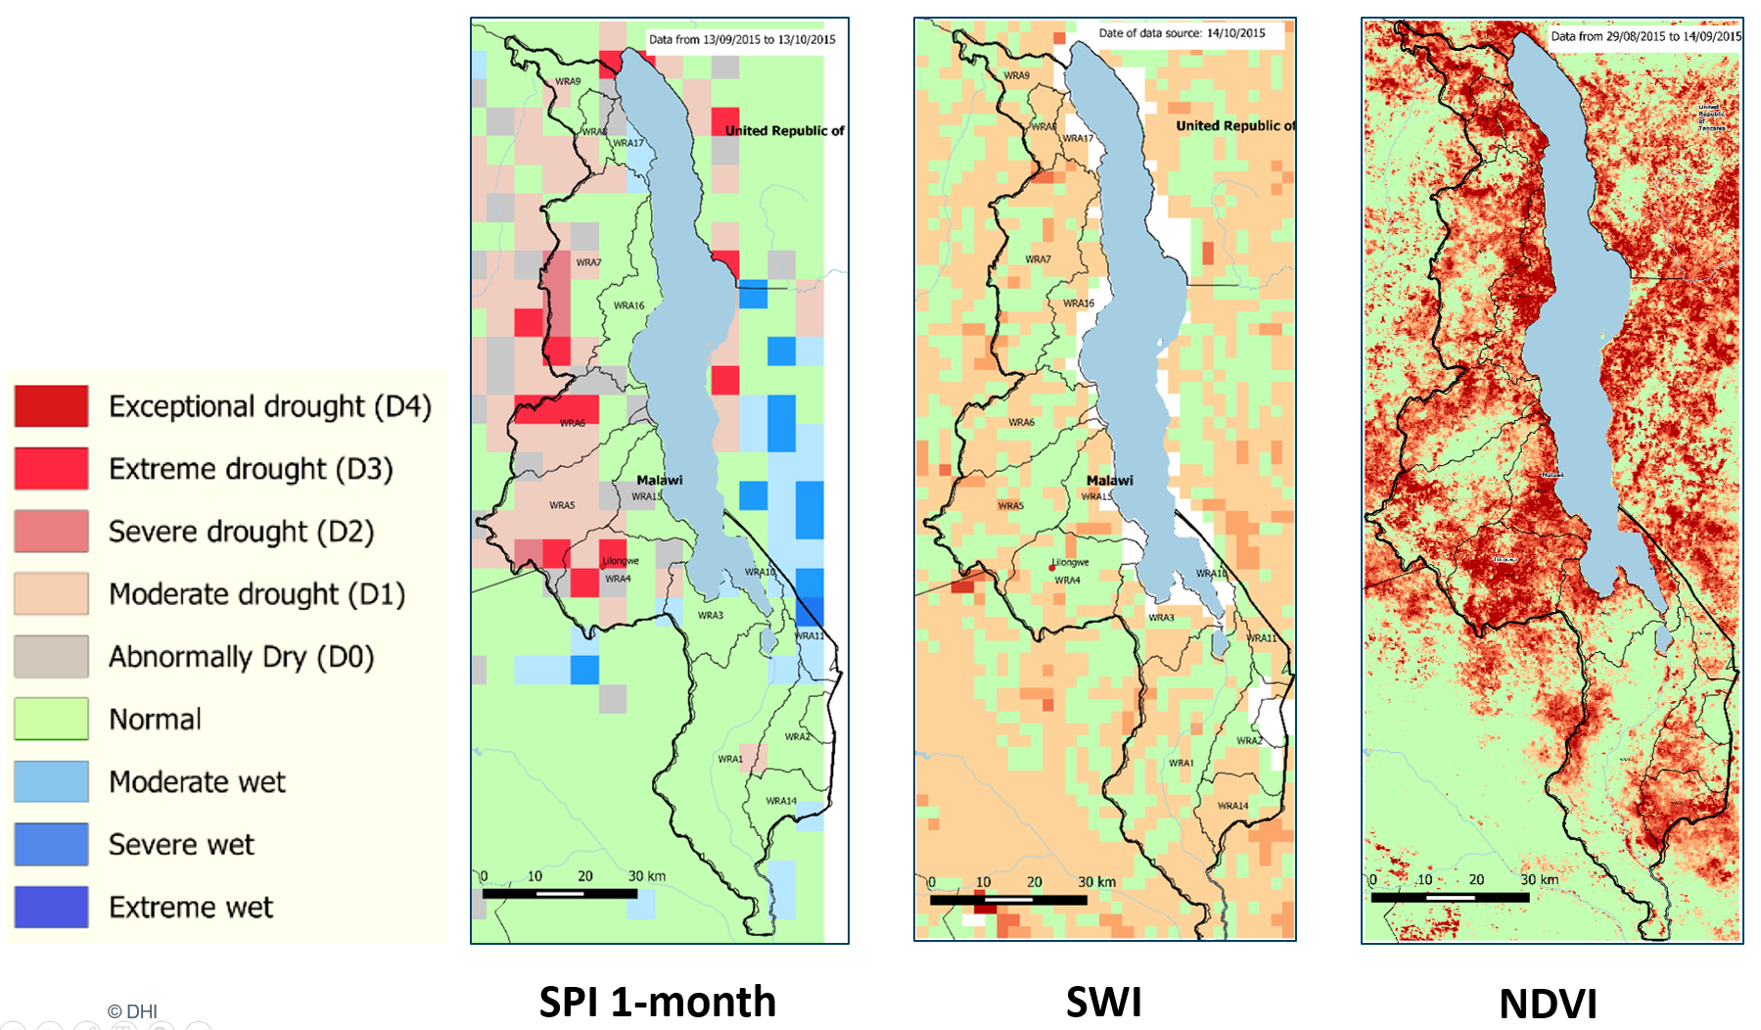
Drought monitoring from space

Slide 14
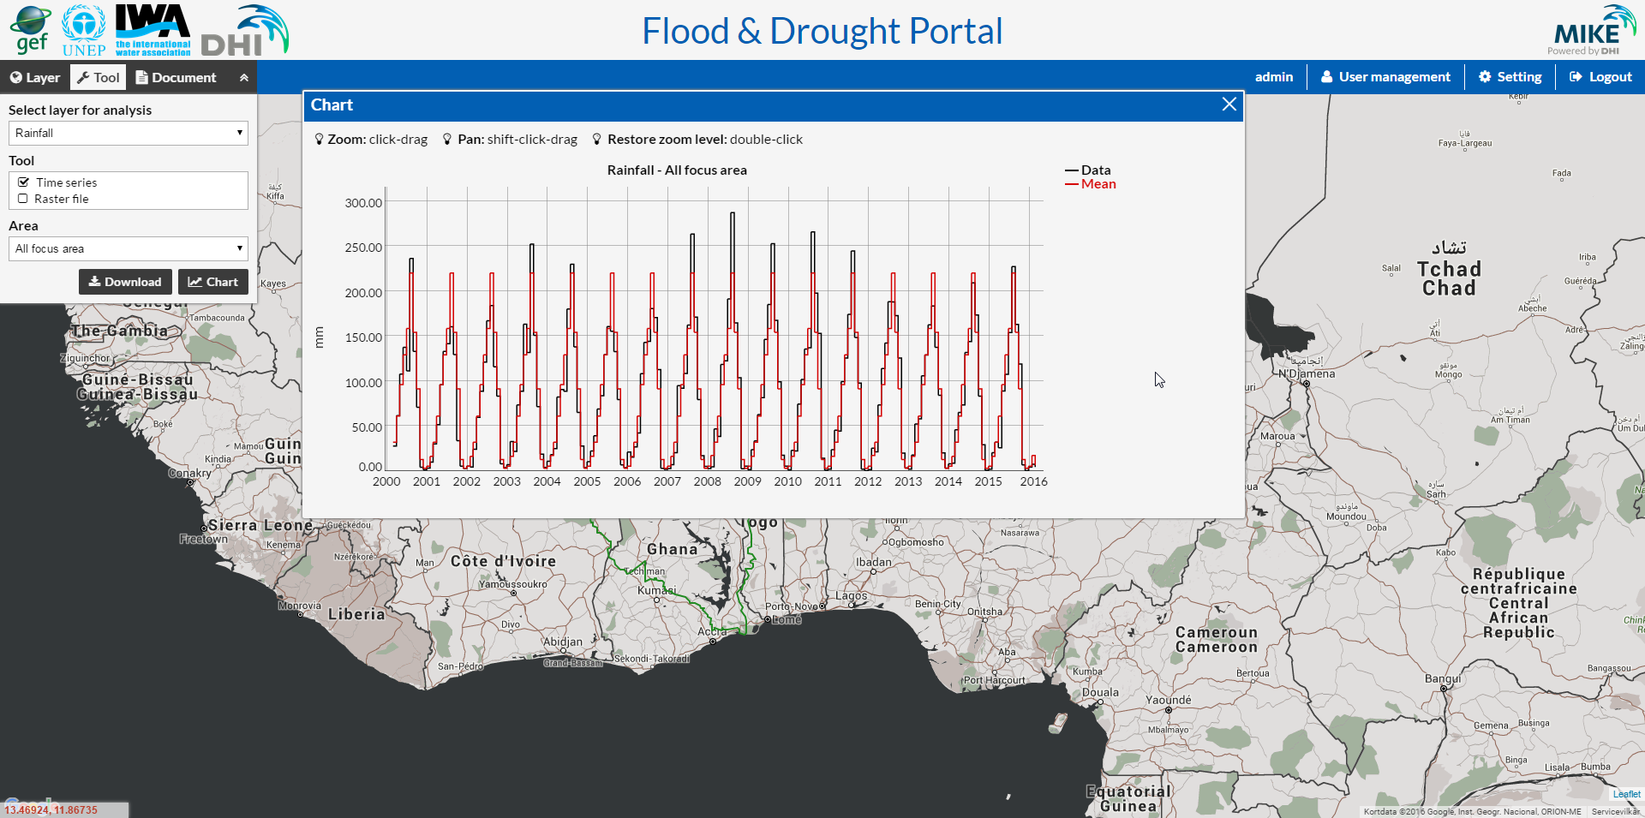
To be used as input data for analysis, models or other tools.
Data download
Area weighted time series for the whole basin, subareas or point locations
Data portal

Slide 15
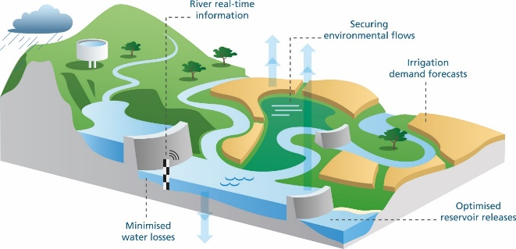
NHP WRIS & DSS
Systems planned at national and sub-national level:
Water Resources Information Systems, including real-time data acquisition
DSS for water resources planning and management
Real-time systems for flood forecasting and reservoir operation

Slide 16
MoWR, RD&GR
Implementing Agency
Academia
Collaborating
Institutions
River Basin Organizations
Implementing Agency
NCMRWF
IMD
Implementing Agency
WRIS
DSS
Implementing Agency
Implementing Agency
Central Government Agencies
Implementing Agency
Implementing Agency
Implementing Agency
Implementing Agency
State / UT Agencies

Slide 17
MoWR, RD&GR
Implementing Agency
Academia
Collaborating
Institutions
River Basin Organizations
Implementing Agency
NCMRWF
IMD
Centre of Excellence
Implementing Agency
Web-, Data- and Application servers
Cloud hosting
Implementing Agency
Implementing Agency
Central Government Agencies
Implementing Agency
Implementing Agency
Implementing Agency
Implementing Agency
State / UT Agencies

Slide 18
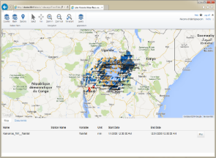
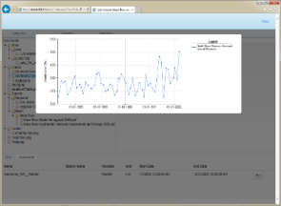
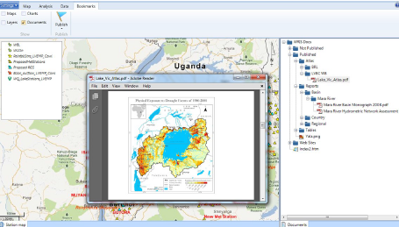
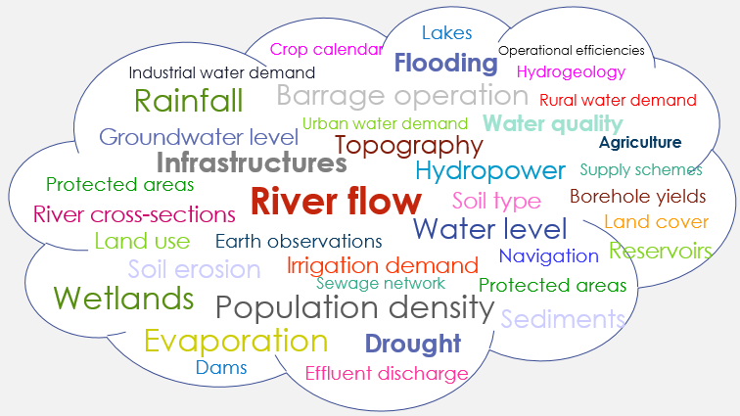
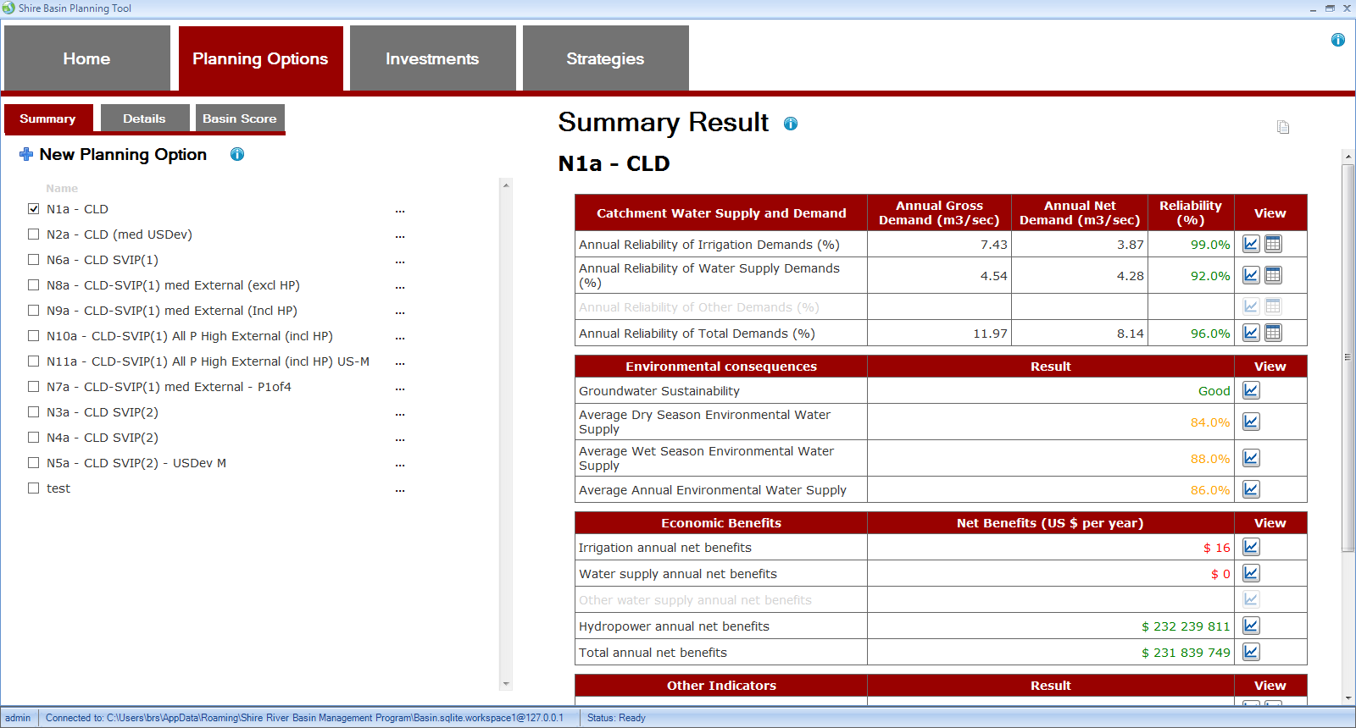
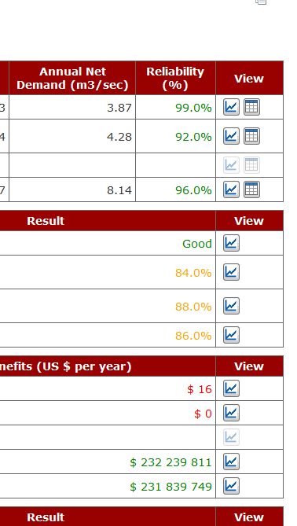
Severs in the Cloud
Web server
Database server
Application server
Implementing Agency (office or field)
Apps accessible on cloud servers or installed on office clients for online or offline use

Slide 19
WRIS / DSS systems
Integrated - one coherent system with data, models, and DSS
Open – to other data sources and tools to accommodate user needs
Expandable – as new requirements are identified or new opportunities arise.
Robust – resilient database configuration and well-proven tools
Maintainable - easy and safe updating mechanisms when improved methods and software packages are available

Slide 20
Thank you
Hans Christian Ammentorp
hca@dhigroup.com

